Slide 1
Modern Software Development and HTML

Slide 2
Key Topics
Programming
Binary
Applications
HTML introduction

Slide 3
How Does Programming Work?

Slide 4
Basic Terms
Programming: writing source code that gives the computer instructions
Source code: code that we write that makes up a program
Program: a group of instructions bundled together to perform one main task

Slide 5
Process from Source Code to Execution
Machine code
aka binary
1s and 0s are the only values
Lowest level language that is what the computer understands
Assembly: lowest level programming language
Taken in by the CPU and assembled into binary
Very simple instructions and a lot of them
Specific to the type of CPU
High Level programming language: easier for the developer to read and write
Compiled: entire source code is translated from one language to another language using a compiler
this is called ahead of time compilation
Interpreted: source code is translated and executed line by line by an interpreter
this is called just in time compilation
Usually interpreted languages are meant to run in a specific environment, like the browser or a shell

Slide 6

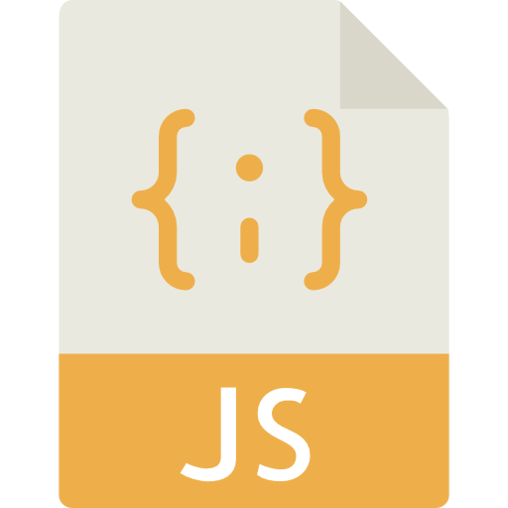

Process from Source Code to Execution
Compiler
Interpreter
High Level Language
Low Level Language
Notes:
Computer with Person icon from Monkik at flaticon.com JS Code icon from Smashicons at flaticon.com
Computer with Binary icon from Freepik at flaticon.com

Slide 7
What is Binary?

Slide 8
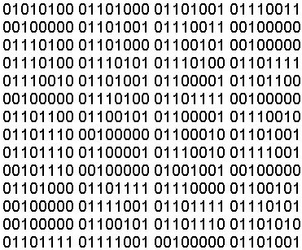
Binary
Uses the base 2 numeric system
Us humans use base 10
Grouped into 8 bits, aka a byte
A byte can represent 256 total values (0 – 255)

Slide 9
Base 10 Numeric Counting
0
0
0
0
0
0
4
2
10³
10²
10¹
10⁰
1000
100
10
1
What if we didn’t know what this number represented?
Understand how to get the base values
Multiply the base value and the digit in that column
10 x 4 = 40
1 x 2 = 2
Add up every column’s product
40 x 2 = 42

Slide 10
Base 2 Numeric Counting
0
0
1
0
1
0
1
0
2⁷
2⁶
2⁵
2⁴
2³
2²
2¹
2⁰
128
64
32
16
8
4
2
1
The same rules apply with binary!
The sum of the values of every column represents a number
To get the value of a specific column, multiply the base and the digit
32 x 1 = 32
8 x 1 = 8
2 x 1 = 2
Add that up together to get 42

Slide 11
What is an Application?

Slide 12
What is an Application?
An application is a computer program with an interface, enabling people to use the computer as a tool to accomplish a specific task – from dictonary.com
Interface: provides a means of interaction between two things. Two types:
GUI: graphical user interface
uses color, buttons, graphics for the user to use to interact with the program
CLI: command-line interface
uses mostly text-based commands for the user to use to interact with the program

Slide 13


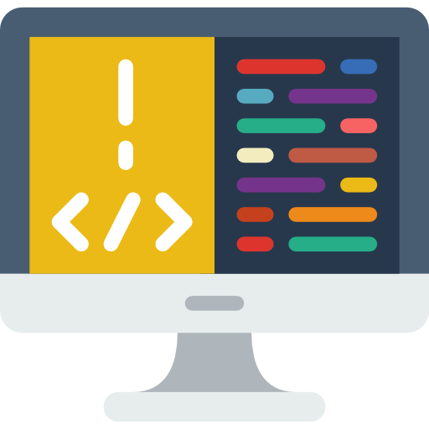


Client-Server-Database Architecture
Client
Server
Database
Devices communicate over protocols
Protocol: standard means of communication between devices
Data sent to and from devices are called payloads
HTTP is the protocol used by the world wide web
Notes:
Back End Computer icon by prettycons from flaticons.com
Browser and Phone icon by Freepik from flaticons.com
Database Computer icon by Freepik from flaticons.com
Plug icon by Freepik from flaticons.com
Envelope icon by Dinosoftlabs from flaticons.com
Cycle icon by Flat Icons from flaticons.com

Slide 14
Libraries and Frameworks
Library: utilities written by someone else to perform complex work with a simple(r) API.
JQuery: JavaScript library for simplifying many common JavaScript tasks
Bootstrap: takes a lot of the complexity out of styling your HTML
You are in control of how and when to use the library
Framework: Larger utilities designed to give you an initial structure for your program.
Express: JavaScript framework for building web applications
Spring: Java framework for building applications that are extremely easy to expand and test
The framework is in control of how your program is structured and written

Slide 15
What is HTML?

Slide 16
Markup Language
NOT a programming language
Programming languages are used to give the computer instructions
Markup languages are used to give describe or format content
Content can be text, image, videos, etc

Slide 17
Browsers
Browser: application that is used to surf the world wide web
World Wide Web: network of webpages that have content we can view and interact with
Webpages are also known as hypertext.
They can be linked together to navigate between them
Webpages have addresses or URLs that allows us to find them

Slide 18
Web Browsers and Source Files
Web browsers can read and understand HTML, CSS, and JavaScript
HTML: Hypertext Markup Language
markup language that structures and describes web content
The browser renders (draws) HTML documents into static content the user can view
CSS: Cascading Stylesheets
can be used to change how the browser displays HTML content
JavaScript: programming language that can be used to cause the browser to perform additional tasks and modify the HTML or CSS used to render a file.
Allows for dynamic content

Slide 19
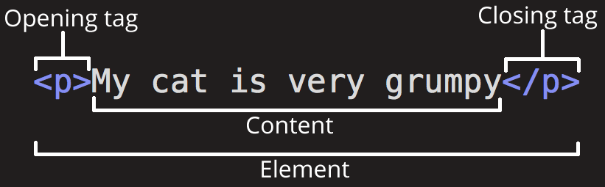
HTML
Markup language that is made up of elements
Element: building blocks of your HTML document
Can represent information about your document
Can represent an individual piece of content

Slide 20
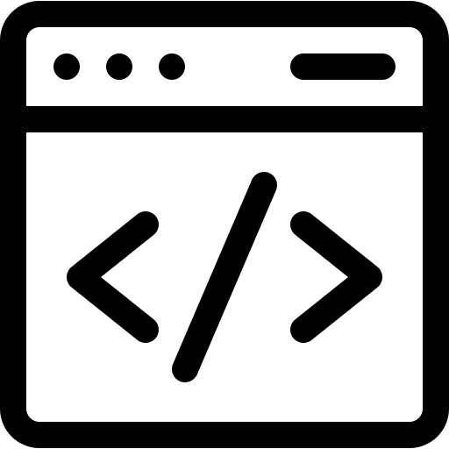
Mandatory Elements
Every HTML page must have these 5 elements to be “valid”:
!DOCTYPE
html
head
title
body
<!DOCTYPE html>
<html>
<head>
<title></title>
</head>
<body>
</body>
</html>
Notes:
Demonstrate using Notepad
Code icon by Freepik from flaticons.com

Slide 21
Inline and Block elements
Every element that represents content has a default display
Inline elements can be positioned next to each other horizontally
<a>, <span>, <strong>, <em>, etc.
Block elements create a “block” the width of their parent (they “block” elements from sitting to the left or right of them)
<p>, <div>, <ol>, <br /> , etc.
Notes:
Demonstrate using VS Code

Slide 22
Common HTML Attributes
Attributes add “metadata” to an element
they describe what the element is doing.
Some attributes are only used with specific HTML elements
Other attributes are usable by every HTML element
id=“value”: used to give a unique ID to a single element
class=“value” : used to group elements for styling or scripting purposes.
Can have multiple values separated by spaces
style=“key:value;”: used to set styling directly on an element.
Can have multiple key:value pairs, separated by semicolons (;)
Notes:
If time, anchor tag demonstration

Slide 23
Resources
Tools
You can write HTML code in any text editor
You can run HTML code in any web browser
HTML Resources
https://www.w3schools.com/html/
https://developer.mozilla.org/en-US/docs/Web/HTML
General Tech Related Resources
https://techterms.com/

Slide 24
Recall
How does programming work?
What is binary?
What is an application?
What are libraries and frameworks?
What is a markup language?
What is HTML?
What are some resources I can use to further my learning?

